Slide 1

GCP ASSIGNMENT - GERMANY
GCP ASSIGNMENT - GERMANY

Slide 2
Agenda
Taxation
Self Read
Know your Support Functions
Before You Go
GCP Benefits & Entitlements
Actions while On GCP
GCP Overview
Annexure

Slide 3

GCP OVERVIEW

Slide 4



ATCI Global Careers Program Footprint
We have GCP presence in the following 30 countries
Norway
Finland
NL
Sweden
UK
Canada
Ireland
Latvia
Germany
France
Czech Rep
USA
Slovakia
Spain
Italy
Japan
China
Mexico
UAE
HK
Saudi Arabia
Thailand
Phil
Malaysia
Indonesia
NZ
Singapore
South Africa
Mauritius
Australia

Slide 5






ATCI Global Careers Program( Policy 750)
Long term cross border
assignments of duration
6 to 12 months
Employee
headcount in ATCI
ceases and is
transferred to the
GCP country
headcount
Dependents can
accompany
Employees are on
host country
payroll and are paid
as per Host Country
Compensation
Model
Employees are to
abide by home &
host country specific
laws while on
GCP
At the end of
assignment the
employee will either
be
re-staffed or be
expected to
return to India
ATCI Global Careers Program( Policy 750)

Slide 6
ATCI Global Careers Program( Policy 750)
General Information
A limited contract can only be issued up to a maximum of 24 months regardless of the client contract validity period.
GCP reporting date at Germany (Can only be on 1st or 16th of the month if it is Fresh GCP or P710 to GCP Conversion).
Employee to reach the host country a day prior to the GCP reporting date
Employees are suggested to book the travel tickets for their GCP assignment from their respective work location and not from their home location
Guidelines & Approvals:
Do not charge time to the offshore WBS element, when on GCP
Reach out to the onsite Project Manager for the appropriate WBS element for charging your time in the Germany
Reimbursements:
For expenses incurred in India and to be claimed in Germany use the currency conversions published on ALLSEC to convert the claim amount into the Germany currency within 3 months of incurring the expense
Claim the converted amount on Germany myTE
Expense Type | Germany WBSe (ATCI) | Germany WBSe (AVANADE) | Germany WBSe (IO) | Germany WBSe (IO - AVANADE)
Air Travel | AIS41001 | AIS5G001 | A8VSW001 | A8YWI001
Visa Costs | AIS43001 | AIS5I001 | A8VSX001 | A8YWK001
Relocation Allowance / Forex transaction | AIS44001 | AIS5J001 | A8VS1001 | A8YWS001
Excess Baggage | AIS46001 | AIS5L001 | A8VSZ001 | A8YWO001
Airport Transfers | AIS47001 | AIS5M001 | A8VSY001 | A8YWM001

Slide 7
GCP enablement process flow
*
VISA is initiated in PMG tool
Role ID needs to be created on MyScheduling
RRD in ABACUS to mirror MyScheduling
Employee View : Log into GCP HUB > View GCP Process Status
Once all the mandatory tasks are closed, employee is eligible to raise the travel request on the e-travel tool. Please note you can raise the request immediately post mandatory task closure or minimum 8 working days in advance to the GCP start date
Request raised for days beyond the above mentioned SLA will be automatically restricted on the E-travel portal
*
Stamped visa copy to be uploaded on GCP HUB
*
Accenture Onsite Leadership Approval
*
Emergency Contact, Dependent details and Salary advance
*
GCP Initiation
Travel Request to be raised
*
GCP Checklist Request ID
*
Salary Mail sent to the employee
Stamped visa copy to be uploaded on GCP HUB
Travel itinerary Details updated on GTT and Final alert by GCP HR
Fresh GCP and Fresh GCP on GCP – Travel Ticket to be shared 7 working days in advance to the GCP start date
*
Mandatory Check
*
Compensation Calculation
*
Addendum and
Salary Agreement
ATCI Project Manager
GCP HR Team
*
HR Policy Briefing
Transfer Template to be downloaded from GTT
Compensation Team
*
Important Note
ECS Team
Capture Taxation Approval
Visa request to be initiated on the People Mobility Gateway tool only once the GCP salary is accepted and the onshore MD has approved the GCP assignment. Please refer to the “GCP status” tab on the GCP HUB to know the status GCP HUB (accenture.com)
Employee Hired on Host Country SAP
Employee
People Mobility
Report Onshore
Onshore PA
* Mandatory tasks to be closed
India SAP Team

Slide 8

KNOW YOUR SUPPORT
FUNCTIONS

Slide 9



Know your Support Functions
Before starting on GCP - To ensure that transfer from ATCI to Germany happens smoothly, employees are provided offshore HR Support until the employee leaves home country.
Stage 1 POC
Have a GCP Query ? Ask GEMS
Click here to meet GEMS!!!
HR Helpline: 2222 - (from Accenture Landline) 08067581222 or 08043381222 - (from any external phone)
Stage 2 POC
Support for Enablement of GCP formalities ATCI GCP HR: meghna.raju.s
Stage 3 POC
Support post arrival in Germany Onshore GCP HR: gcp.hr.germany@accenture.com

Slide 10
STAKEHOLDER SUPPORT FUNCTIONS & REFERENCES
GCP Policy Link- Global
My Learning
Forex
GCP Policy Link- India Supplement
GCP Websites
MyTE
Host Country Policy Addendum
Accenture Workplace
Support
GCP Provisions for Career Level 7 & above
Functions
Payroll & Finance related queries
GCP Costing and Operating Guide
ECS/HR Helpline
GCP HUB
E-Travel
GCP Policy Briefing Deck
Accenture Portal
http://go.accenture.com/pmgateway
To Change Password
Information on visa/ immigration matters please visit
IT assets to Asset team
Onsite Transition Checklist
International Travel and Medical Insurance
AST Team
Have a GCP Query ? Ask GEMS
Click here to meet GEMS!!!
Assets and Logistics
DCN (Tech Clearance)
EY Link -Username: MobileExecUser
(Taxation) Password: tax2k6

Slide 11

BEFORE YOU GO

Slide 12
Action From The Employee On GCP HUB
Move the cursor over the individual boxes for each task description
All tasks highlighted in GCP HUB needs to be closed at-least 7 working days (before 1:00pm IST) in advance to the GCP start.
For example:
!!! Failure to share confirmed e-ticket with GCP People Advisor before 1:00 PM of the cutoff date will to lead to cancellation/rescheduling of your tickets & delay in GCP travel and reporting date.
Traveling without the completion of these mandatory tasks and without informing the ATCI GCP HR, is considered as non compliance and further actions will be taken
If any changes in the GCP start date post final alert release, notify the GCP HR immediately
Employment Contract is released by Onshore GCP People Advisor & Visa request to be initiated on PMSD tool only once the GCP salary is accepted
In case you have the pending old GCP checklist request on the AST tool which is restricting you to raise a new GCP checklist for the new assignment, its mandatory to close the pending checklist with required approvals
1. Capture Accenture Leadership Approval
6.Provide Emergency contact, dependent details
9. Raise Travel Request
Reporting date | Cut-Off date
16th Jan, 2020 | 7th Jan, 2020 (before 1:00pm IST)
4. Capture Passport details
2. Attend HR policy briefing session
7. Salary agreement & Addendum
5. Capture Taxation Approval
10. Provide travel Tickets
3. Raise GCP checklist ID
8. Share Visa Copy

Slide 13
Action From Employee On People Mobility Gateway Tool – Visa process
VISA Request:
Initiate visa on http://go.accenture.com/pmgateway using GCP WBS
Employee who already hold a visa needs to validate their Visa details with PMSD & share the confirmation mail with ATCI GCP HR along with confirmed travel itinerary.
.
Dependents’ visas to be processed along with their own regardless of travel schedule to avoid additional costs unless there is some avoidable reasons
Visa/ Work Permit application will be supported by German Relocation Service Provider-Across Relocation mobility-relocation. The employee will be contacted by HR mobility-relocation as soon as he/she sends the Employment Contract back to Germany GCP HR (gcp.hr.germany@accenture.com) via e-mail
Assistance Required:
For basic information on visa/ immigration matters please visit GCP HUB (accenture.com)
For general PMSD inquiries:
If you are an Accenture employee please visit Service Now Tool
If you are an Avanade employee please submit your inquiry to RMS.Avanade@accenture.com
You may contact PMSD via toll : +0008004420110 (can only be dialed from within India) or +13128435068 (may be dialed from anywhere)
Important Note
As per the changes in visa application process, employees will be able to apply for dependents visa for their spouse & children only if their work contract at the time of application is valid for 1 year or more. It is therefore recommended to apply for dependents visa at the time of applying visa for self (provided the work contract is valid for 1 year or more

Slide 14
Visa Processing Steps
Initiates the visa request on http://go.accenture.com/pmgateway post accepting the GCP salary
Provides complete documentation/information required for visa application.
Documentation Required : MyScheduling CV format, Translation of Degree, CV and Health insurance confirmation to German Language
Kindly reach out to ferdinand.a.dsouza for insurance for visa purposes and PM.Asgr.cst for Letter of Invitation which is also required for visa application
Employees can raise request for proof of employment on AST tool
GCP Assignee
Germany visa :
Maximum duration allowed in country:
Up to 24 months
People Mobility
Collects paperwork and required documents
Submits the visa application to the Authorities
Notifies the GCP assignee of the visa approval and shares a scanned copy
Estimated Timelines : 1 – 2 months
For more information on GCP, please contact People Mobility on Service Now Tool / People Mobility Question / Temporary Transfer GCP. Please refer the attached FAQs on how to claim expenses incurred during visa processing - - - - - >
**Please note : The immigration guidelines and visa related documentation is subject to frequent changes and hence please do refer to the People Mobility website (https://in.accenture.com/peoplemobility/) for latest details

Slide 15
Mandatory Closures
Transfer Details to be shared with GCP HR :
Once visa is stamped post that within one working day employee needs to share below mentioned details with country specific GCP PA at least 7 working days in advance of the target GCP reporting date.
Confirmed travel e-ticket (soft copy of travel tickets)
GCP start date (1st or 16th of the month)
Employees who already hold a valid visa for Germany must get the same validated by PMSD Team and share it along with the above information. Employee to reach the host country a day prior to the GCP reporting date
The employee is required to upload visa copy on GCP HUB at least 6 working days prior to target GCP reporting date.
Please note that, even if one of the above documents are sent late, the team will not be able to process the GCP transfer for the agreed date and will need to move the dates forward. We strongly recommend the employee and the project to adhere to these timeline. No negotiations on the timelines will be entertained.
Incase there is a delay on sharing the requisite details (confirmed travel itinerary), there will be delay in the GCP transfer process which will intend delay the below processes:
Controllership clearance
Advance salary processing
SAP ID generation
Laptop arrangement
Headcount transfer
Onshore MYTE submission
Salary in host country
Important Note
Failure to share confirmed e-ticket with GCP PA at least 7 working days prior to the GCP start date will to lead cancellation/rescheduling of your tickets & delay in GCP travel and reporting date
Individual will not have the authority from Accenture to work in Germany if the GCP transfer process is not completed. This also means that any health and safety/employee/employer legislation/protection would be invalid and puts both the employee and Accenture at risk

Slide 16
GCP Checklist & Mandatory Closures
These activities
have to be
completed at least
7 working days
prior to the GCP
reporting date
Initiate Onsite transition checklist on AST tool once GCP is initiated.
Work with the respective team for the Onsite transition checklist closure
Close the checklist ID task on the GCP HUB by updating the request number post 24hrs of raising the checklist
Do not wait for all the approvals to update the request number on the GCP HUB to close the task.
GCP Checklist:
Note- It takes 1 working day for all the details on AST to flow into the GCP HUB and vice versa (including GCP start date)
Submitting myTe till your last working day in Accenture India
Launch MyTimeandExpenses Tool (https://myte.accenture.com/)
In the 5/31/2019 Time screen, click on Work schedule
Click on Create Tab against 'Custom work schedule for this period only'.
Remove the standard working hours charged on after 5/16/2019 (here from 5/16/2019 to 5/31/2019 ).
Click on Save
Enter Time and Expenses (if any) for days that you spent in ACTi in that fortnight
Submit the Time Report
How to get the Controllership checklist clearance
Please ensure that the entire outstanding amount is settled and you submit the Time sheet and reimbursements to be claimed in ATCi
You can confirm your GCP Start date by raising a request on https://support.accenture.com/ under Human Resources and Payroll > Time and Expense > Ask a question>'employee onsite clearance' -Global Career Program’
Your individual spoc details will be mentioned on the checklist itself in the “Approved By” section of the AST checklist
Please note – Controllership team follows 3 days SLA to validate the request post raising of checklist

Slide 17



Finance Clearance before you travel
Important Note
Failure to complete approval in the Finance & Controllership checklist will prevent the issue of the Forex Card and salary advance
Submit your Time sheet:
The employee needs to submit time report till his/her last working day in India. ex:
If an employee’s last working day in ATCI is Oct 26, then while submitting TR for Oct 31 time period, the following steps need to be taken
Login to MyTimeandExpenses Tool (https://myte.accenture.com/)
In the October 31 Time screen, click on Work schedule
Click on Create Tab against ‘Custom work schedule for this period only’
Remove the standard working hours charged on days after the separation (here from October 27 to October 31)
Click on Save
Enter Time and Expenses (if any) for days that the employee was active
Submit the Time Report
Expense :
Claims made in past two Time Periods – Employee needs to ensure that supporting has been dropped in the drop box
No Claims in past two Time Period and for Future Time Period – No Action from employee
Future Claims - Employee needs to confirm that supporting has been dropped for the future claims
Car Lease : To foreclose the balance amount, please follow the steps as per the attached document, failure to which will be treated as non compliance:
If you have opted for Car lease from Accenture, please ensure you action on below steps within 2 working days receiving the selection email from the GCP HUB.
If Carlease availed and employee going to GCP, he/she need to foreclose the car by paying outstanding lease rental and RV amount. To know foreclose value please raise a query in ServiceNow by
attaching the GCP confirmation mail. Unless the car is foreclosed, and car ownership transferred Finance clearance will be kept on hold in GCP HUB.
Contact Payroll team: Raise a request in support.accenture.com by selecting Human Resources and Payroll, category as carlease, sub category as Foreclosure, Transfer & Policy and make sure to attach approved travel & return date confirmation from concern team.

Slide 18
Actions for employee on AST
GCP Transition checklist request should be raised 8-10 working days before the employee’s travel date. The path to raise the Checklist is : AST Tool → New Request → Raise GCP Checklist
Below are the approvals which need to be procured by the employee on the GCP checklist.
Checklist Stakeholders | POC | Specific Path
Project Manager | DU Project Manager | Contact POC: ATCI project manager Action: employee to contact the ATCI Project manager to close the task on the tool In case the project manager has exited the organization, then the current request has to be canceled and new checklist has to be raised
Accenture Workplace | Accenture Workplace Team | Contact POC: Your local facilities helpdesk Action: You need to connect with your local workplace team (LHD/FNS Team) to close this checklist and ensure that you submit your cabin key, parking sticker etc. to workplace team before your transfer You can also call 2222 for support
DCN ISU | Tech Team | Contact POC: Your local tech support team Action: You need to ensure that you submit your ATCI assets to your local tech team to close the checklist. If you don't have ATCI asset, then the same will be closed post your LWD in India. You can also call 08040775555 to know more details
Controllership** | Finance | Refer to the next slide to get the controllership clearance
Library | Library team | Contact POC: Your local facilities Library Action: Ensure to return all your library books (if availed) to the respective location Library

Slide 19
Controllership Clearance
Car lease
To foreclose the balance amount, please follow the steps as per the attached document, failure to which will be treated as non compliance:
If you have opted for Car lease from Accenture, please ensure you action on below steps within 2 working days receiving the selection email from the GCP HUB.
If Car lease availed and employee going to GCP, he/she need to foreclose the car by paying outstanding lease rental and RV amount. To know foreclose value please raise a query in ServiceNow by attaching the GCP confirmation mail. Unless the car is foreclosed, and car ownership transferred Finance clearance will be kept on hold in GCP HUB.
Contact Payroll team: Raise a request in support.accenture.com by selecting Human Resources and Payroll, category as car lease, sub category as Foreclosure, Transfer & Policy and make sure to attach approved travel & return date confirmation from concern team.
MYTE
Submitting myTe till your last working day in Accenture India
Launch MyTimeandExpenses Tool (Myte)
In the 5/31/2019 Time screen, click on Work schedule
Click on Create Tab against 'Custom work schedule for this period only'.
Remove the standard working hours charged on after 5/16/2019 (here from 5/16/2019 to 5/31/2019 ).
Click on Save
Enter Time and Expenses (if any) for days that you spent in ACTi in that fortnight
Submit the Time Report
Note**:- Employee must attach the scanned copy of claim receipts for last 2 time periods in ATCI in the Service now query initiated for controllership approval.
Note- It takes 1 working day for all the details on AST to flow into the GCP HUB and vice versa (including GCP start date)

Slide 20
Controllership Clearance
How to get the Controllership checklist clearance
1. Please ensure that the entire outstanding amount is settled and you submit the Time sheet and reimbursements to be claimed in ATCi
2. You can confirm your GCP Start date by raising a request on https://support.accenture.com/ under Human Resources and Payroll > Time and Expense > Ask a question>'employee onsite clearance' -Global Career Program’
3. Your individual spoc details will be mentioned on the checklist itself in the “Approved By” section of the AST checklist
Please note – Controllership team follows 3 days SLA to validate the request post raising of checklist
Controllership Approval has to be cleared at least before your GCP travel
Initiate Onsite transition checklist on AST tool once GCP is initiated.
Work with the respective team for the Onsite transition checklist closure
Close the checklist ID task on the GCP HUB by updating the request number post 24hrs of raising the checklist
Do not wait for all the approvals to update the request number on the GCP HUB to close the task.

Slide 21
Provident Fund (PF)- Aadhaar KYC
Provident Fund
Please check for Provident Fund (PF) Aadhaar KYC completion
To Ensure that Provident Fund (PF) -Aadhaar KYC is completed , failure to which will be treated as non-compliance:
If you have opted for Provident Fund please ensure that you have a valid & latest Aadhaar ( updated with complete date of birth in DD/MM/YYYY format and an active & accessible mobile number ) , and same is updated to your PF- Universal Account Number (UAN) within 2 working days receiving the selection email from the GCP HUB (https://gcphub.accenture.com/)
Please refer the video aid on the link https://mediaexchange.accenture.com/media/t/1_03t8n3sx​​​​​​​ to check and update Aadhaar KYC
Your details (Name, date of birth, gender, India mobile number)as per Aadhaar records must match the details on the PF portal, else follow steps in the attachment and take corrective actions.
If you have queries, raise a ticket on ServiceNow
Select Country/Location “India”
Select Category – Provident Fund
Sub-category 1 – Provident Fund-GCP
Short description– “Aadhaar – KYC for GCP check list ”
Description – mention your query in the text box
Click on CREATE A REQUEST to submit

Slide 22
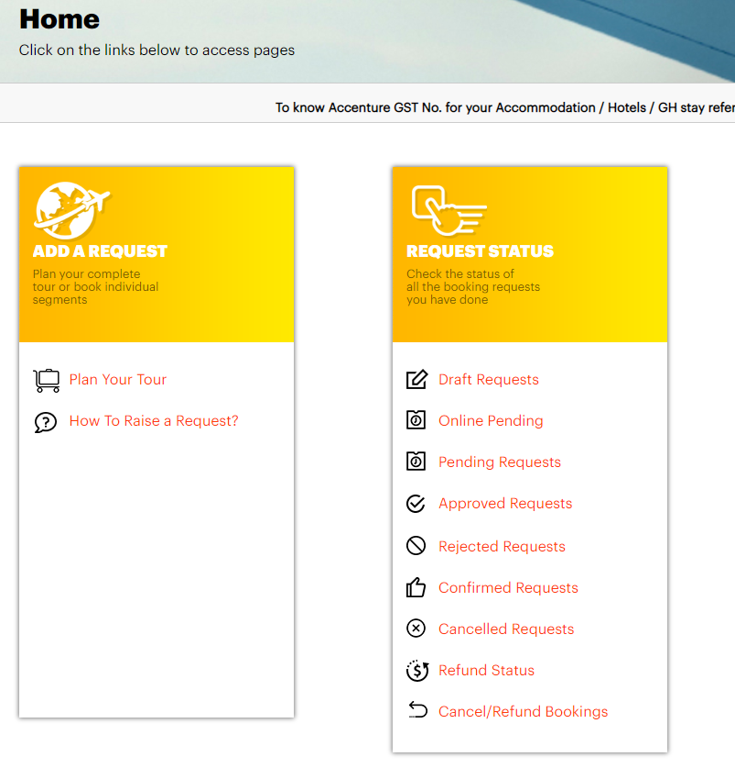
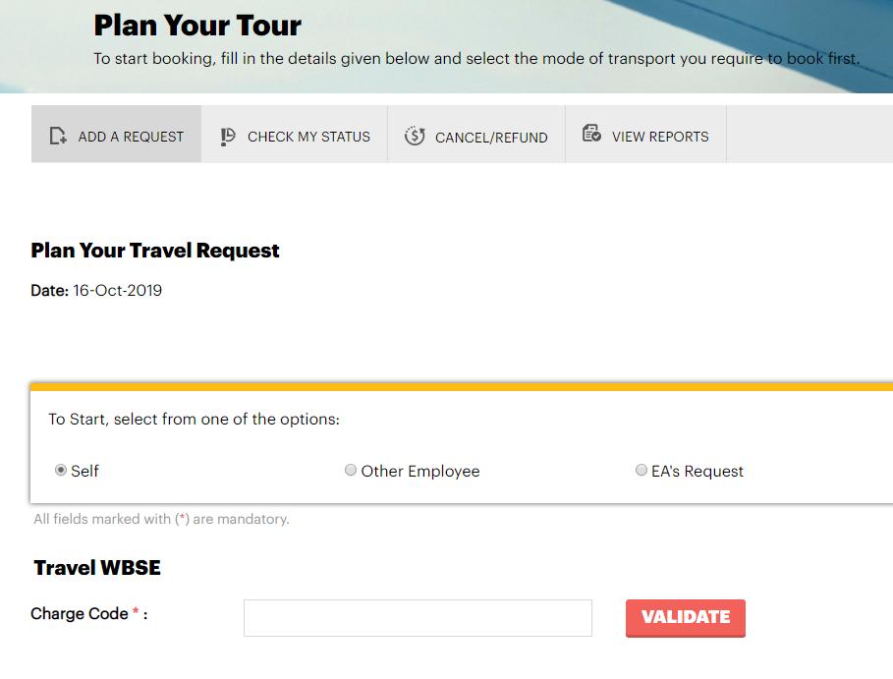
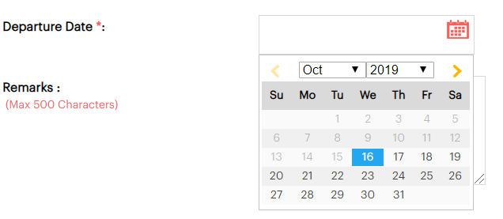
International Travel Request on E-travel Portal
Have you completed all the mandatory tasks? You are then ready to book the travel tickets….do ensure to raise the request at least 8 working days in advance the GCP start date.
Path to raise>> E- Travel Home Page>> Plan your tour. Refer the document attached in the E-travel home page.
The approver for the travel request has to be respective business unit MD only.
Page 1: You will be allowed to raise the request only once the mandatory tasks are closed. Use the valid GCP WBSe as provided in this deck
Page 3: Request to be raised immediately after closing mandatory task or minimum 5 working days in advance to the GCP Start date

Slide 23

Technology Support related actions before travel (MANDATORY)
The following steps are to be mandatorily completed prior to commencing your travel, in order to receive timely support from LTS locations.
Reset Enterprise Password
To retain access to Domain ID until the domain is moved to local OU(75 days for next EID password reset is considered)
Authenticate new password by entering EID in link below ChangePassword
Email notification will be received if the change was successful and will be effective immediately.
Call 5555 if faced with any issue
For any Escalation please reach out to Service Desk Lead (John j.d.thomas@accenture.com
IT Assets Handover
Check in https://adminsupporttools.accenture.com/CAT to confirm the IT assets assigned / tagged to the individual
All IT assets are bonded and has to be returned in the source(issued) location. In case this is not done, there would be challenges in getting a clearance to travel.
Data Transfer
Ensure to have a Valid WBSe and appropriate approvals from the Client and Project DU lead for the data transfer at least 1 week prior to the LWD
Data transfer can be done by following methods by logging requests in Accenture Support
Please procure an approval from Security team IS.ISA.India.OST@accenture.com
Laptop Re-issuance
Project POC to raise a laptop request on behalf of the employee
SRM tool:- Laptop Reissuance
To have a laptop when the employee returns back to India. Factor in 2 weeks advance notice

Slide 24
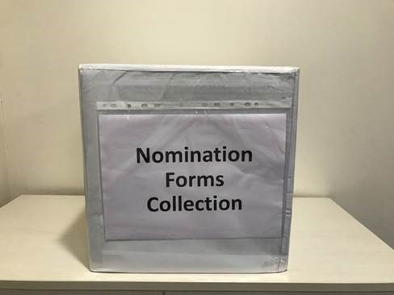
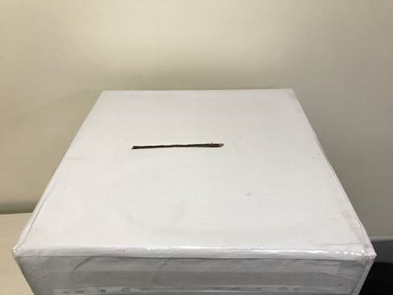
Things To Complete Before Travel - Allsec
Mandatory Action: Submit Hard Copies of Nomination Forms (PF Declaration, GF Declaration & Nomination Form – Other Benefits
Procedure
Drop Box Design
Open Allsec after getting access to it – https://smartpay.allsectech.com/Accenturelogin
Go to Utilities tab
Fill the information in the PF, GF & Nomination Form – Other Benefits
Take print outs of all the three forms
Drop the forms in the “Nomination Forms Collection” drop box in the mailroom
For any queries: Raise a service request through Service Now Tool and select “Ask a Payroll Question” with the Category as “Provident Fund” and the Sub-Category as “Nomination – General query” or “Nomination – Procedure” or “Nomination – Status”.

Slide 25

GCP BENEFITS & ENTITLEMENTS

Slide 26
GCP Compensation
GCP Salary
Variable Pay
The GCP assignee will be transferred to the Germany Payroll System and salary will be paid on monthly basis
Annual GCP salary are aligned with host country guidelines to ensure cost competitiveness, are inline to meet cost of living and to meet the country’s legal statutory compliances.
The annual salary has been computed based on this city in Germany to which you are traveling. Change in your work location may entail changes in your GCP Base Pay. In case of any change in your work location, please keep your Onsite People Advisor informed.
Salary Increment due to promotion and revision will be based on host country guidelines
The entire GCP salary will be paid in the Germany after deducting – Income tax, Statutory benefits etc.
Note:
GCP assignees will not have access to their ATCI compensation plan during their GCP tenure. The same can be accessed once they repatriate to India.
As per the latest guideline, you need to attach exception approval email from your account MD with your myTE submission if your total time charged is more than 125% (25% of total standard hours available in a particular fortnightly/monthly). In case you do not have an approval you may be required to do PPA
Variable Pay: SWF has following variable pay program Individual Performance Bonus (IPB):
Employees between level 13 until level 5 are eligible for the variable pay. If the GCP assignment starts during the Fiscal Year, the variable pay will be paid out on pro-rata basis. The variable pay will be paid out as one-time bonus with the December payroll cycle. The guidelines for the variable pay are based on the current version of the ATS workers council agreement for compensation.
Company Bonus: All employees at level 11 and above are eligible to participate in the Company Bonus Programme. This one time payout bonus is paid annually in Dec, 16. This bonus is subject to you being on the rolls of Accenture on the date of disbursement of this payout and as per Accenture Germany eligibility guidelines
Above Variable Bonus is paid in your Germany bank account. If you repatriate before Variable Bonus payout, then you need to keep the bank account open in Germany till you receive the Variable Bonus earned during the year. Cost incurred to keep the bank account active needs to be picked up by the employee.
For the tenure spent in India, Variable pay amount will be prorated as per the ATCI guidelines and paid in Indian bank account.
Accenture may at any time and in its sole and absolute discretion, amend, suspend, vary and modify any of the terms and conditions of the Variable Bonus program guidelines.
For any queries related to company bonus, please write to gcp.hr.germany@accenture.com

Slide 27
ATCI comp calculation process (post repatriation)
India compensation maintained offline for all employees on GCP
Base Pay:
Last drawn India Base Pay considered as starting point
Revised YOY based on ATCI compensation guidelines and Talent Outcome of the employee
ATCI Total Rewards communicates the compensation to the employee via an email trigger from the mailbox – “India.Compensation” within approximately 10 days of receiving the repat input from SAP team
Next Gen Bonus Program:
Repatriates are covered in ATCI Skill Bonus program subject to them meeting the program guidelines and eligibility criteria at the time of rejoining ATCI.
Also note that:
Allsec portal contains a letter which includes information on the employee’s new Base Pay and other applicable components (eg: ATCI Skill Bonus, Variable Bonus)
Onsite compensation of the employee has no bearing on ATCI compensation.
Sample Illustration:
GCP start date in June 2018 (FY18), and repatriation in April 2020 (FY20)
FY18 Talent Outcome while on GCP
FY19 Talent Outcome while on GCP
FY19 ATCI Compensation
(revision w.e.f 1st Dec-2018)
FY20 ATCI Compensation (revision w.e.f Dec
-2019
FY18 ATCI Compensation
Communicated upon rejoining ATCI in FY20
(Last drawn ATCI salary)
FY19 ATCI Comp increase guidelines
FY20 ATCI Comp increase guidelines

Slide 28
Airport Transfers, Excess Baggage And Relocation Assistance
Level | Excess Baggage (USD) | Airport Transfer (USD)
CL 8 & Below | 560 (each way) | 150 (each way)
CL 7 | 1000 (each Way) | 150 (each way)
CL 6 & above | Refer to the below link for details on Relocation allowance, Excess baggage, Airport transfer and Salary advance: https://policies.accenture.com/Pages/0701-0800/0750_C19.aspx?rd=1&Country=India
 | Supporting Documentation > Provisions for India Accenture Leadership and employees in roles at career levels 6: DC for Technology, India
Excess
Baggage
Employees should also refer to their home
country supplement for additional details on
the provision. Supporting documentation must
be submitted to claim reimbursement of this
expense
The applicable cap amount is for the employee and dependants and no separate amount will be provided for dependants
Onward and Repat journey excess baggage limits cannot be clubbed
Claiming above cap amount will lead to disciplinary actions
Employees transitioning from P710 to GCP or those on dependant visa are not eligible to receive excess baggage & airport transfer unless there is a change in work location
In case of P710 to GCP, if the dependants travel at a later stage, they will be eligible for airport transfer & excess baggage up to an eligible amount as mentioned above
Airport
Transfer
This amount is given to cover
transportation distance from airport to
home/host location and vice versa with in the
city limits. This amount can not be used when
travelling between 2 cities
Important Note
Please submit bills when claiming reimbursement on excess baggage & airport transfer – amounts have to be claimed through myTE as per Global T&E Policy No. 0063

Slide 29
Temporary Living
You are required to book a boarding house for the initial 30 days of temporary living accommodation upon arrival in Germany. You are eligible to reimburse the cost incurred towards this housing in the Time and Expense Reporting application – up to a cap limit listed below based on your management level. For further information on boarding houses, please refer to your Germany orientation materials.
Option 1
Management level | Amount (in EUR)
Accenture Leadership and management Levels 5-7 | 3,000
Management levels 8-9 | 2,500
Management levels 10-11 | 2,000

Slide 30
Salary Advance – Forex Initiation And Process steps
Forex initiation process
PFB the process of getting the salary advance which is loaded in installments
Pre-requisites for initiating the Forex request: Along with the other important tasks (except the final alert), the below tasks on the GCP HUB should be completed:
HR policy briefing session task: Employees should have attended the mandatory HR policy briefing session
GCP checklist request ID task: The GCP checklist ticket number needs to be keyed in the GCP checklist request ID task
Initial salary advance: The initial salary advance will only be provided on receiving the MD approval on the Forex request present on the e-travel portal
Remaining salary advance: The balance salary advance (eligibility- initial salary advance) will be provided on the completion of the following
GCP transfer process/ Final alert initiation: Employees need to share the confirmed travel tickets and visa copy with the ATCI GCP PA as per the GCP transfer process timelines. The GCP transfer process/final alert will be initiated on the GCP HUB
Controllership checklist clearance: The controllership checklist clearance should be approved on the AST tool
Once both the above actions are completed, employee should share the below details with Forex.card team to receive the balance
Steps to be followed on the e-travel site
Enter the GCP WBS and click on validate
Receiving the initial salary advance
The Forex team will load the initial salary advance on receiving the approval from the project MD on the e-travel request
Receiving the remaining salary advance
The balance amount will be loaded once the final alert is released from the GCP HUB by the ATCI GCP PA and the controllership checklist is approved on the AST tool
Enter the Employee and travel details
Select the purpose of the travel as “Global careers program”
Select the next mode of request as “Forex request”
Note:
Its mandatory for all employees to seek the controllership clearance on the AST tool (GCP checklist)
Employees need to ensure the submission of their MYTE as per the Last working date in ATCI and GCP start date confirmed by the ATCI GCP PA
The controllership team provides the clearance in 4 working days on raising the MYTE query on the Service now
In case employee does not require the complete amount, its employee responsibility to inform either the forex team or the GCP PA on the same

Slide 31
Salary Advance Contd…
FOREX Card to be collected from the local helpdesk
Management level | Amount in (EUR)
Accenture Leadership and management levels 5-7 | 6,000
Management levels 8-9 | 5,000
Management levels 10-11 | 3,500
Recovery Clauses
ELIGIBILITY
Eligibility and Recovery
You will receive a one-time salary advance to assist with your relocation to the host country. A salary advance will be paid to you in your home country before you depart.
t is up to the employees’ discretion to avail the salary advance available as per the eligibility guidelines as one can choose not to opt for the same
Salary advance is recoverable through payroll deductions in six equal monthly installments beginning with the third month salary payment in the host country and is subject to taxation
Repat & Exit
If the employee repatriates to the home country or exits the company before the end of the GCP assignment because of project or personal reasons, then any outstanding salary advance amount has to be repaid fully by the employee
If the salary advance is not fully recovered, then any over-due amount will be directly deducted through home or host country payroll through agreed alternate arrangements
Support
Any unrecovered amount at the time of Exit shall be recovered as part of the full & final settlement process
For any query related to FOREX or Salary Advance, write to forex.card@accenture.com
NOTE: Refer the FAQ attached for more clarification on Forex process
Opening NRE account:
Employees can reach out to the attached list of POCs for any assistance in opening the NRE Account
Proof of Employment:
4 copies need to be requested from https://ast.accenture.com/atlas/login.aspx-> New request -> Credence Request -> Proof of Employment -> (Reason ) Produce Proof of employment-> Submit
Take the printouts from AST by clicking on Request Status > Credence Status > (Select Request) > Print

Slide 32

International Business Travel & Travel Insurance
This program provides all Policy 750 participants assistance and insurance for the following:
During your international relocation (traveling internationally to your host country location from your home country location at the start of your temporary country transfer) up to 14 days
During an international business or international training trip that takes you outside your host country
Approved fly backs until the earlier of: the date you return to your place of permanent assignment or temporary residence, the date you return to your place of work, or the date your trip exceeds 30 days
Steps to follow when availing Travel Insurance in case of any Medical Emergency during the initial days of arrival
Employee/Hospital to call up International SOS (service provider for HDFC ERGO) Link International SOS @ +1-215-942-8390
Share Employee Name, HDCF ERGO certificate no, Travel Card No, Passport No ( Available in the Insurance Certificate)
Once they validate the Travel Insurance, employee may claim cashless facility
Else if the expenses are borne by employee, it can be claimed by dropping an email to travelclaims@hdfcergo.com

Slide 33
International Business Travel & Medical Insurance Program
The International Business Travel & Medical Insurance Program has a new site on Travel & Events. Update all your traveler communications relating to this program, including links for Travel Certificates used as insurance documentation for visa or entry. Travel certificates are available at International Business Travel & Medical Insurance Program, scroll down to view the Travel Certificates section.
Relocation coverage
Effective November 10, 2020
Coverage for relocation has been extended from a maximum of 14 days to a maximum of 60 days to allow for longer immigration timelines and quarantine requirements
Refer International Business Travel & Medical Insurance Program for more details
Coverage starts when the traveler leaves their home country and ends upon their start in the destination location, limited to 60 calendar days (including up to 14 personal days). This may vary for India employees, where the Travel Certificate will specify the coverage period as
COVID-19 Coverage
The International Business Travel & Medical Insurance Program covers out of country emergency medical expenses, including COVID-19 diagnostic testing if presenting symptoms and prescribed by a doctor for diagnosis and COVID-19 treatment including, but not limited to: outpatient services, ambulance, inpatient services, and prescription medication. COVID-19 diagnostic testing for any reason other than treating an urgent or emergent medical situation is not covered. Antibody testing is not covered.
Pre-trip COVID-19 testing: : Generally is not covered. Check the Accenture policy (0044, 0710, 0750, 1430) covering the trip regarding testing for flights or visa. Most policies allow reimbursement for routine physicals, vaccinations or other medical services required for travel (such as required pre-trip testing) that are not covered by these programs or the home health insurance.
Plan materials are posted on the portal, such as Summary of Benefits, Travel Certificates and Frequently Asked Questions, which now include all relevant COVID-19 information.
Insurance Certificates
The insurance certificates for relocation are available for travel in 2021 and provide documentation of coverage, including COVID-19:
Program | Insurance Provider | Evidence of COVID-19 Coverage
International Business Travel & Medical Insurance Program Scroll down to view the Travel Certificates section | Employees of India: HDFC Ergo | Epidemic and pandemic language has been integrated into the Standard Certificates. Employee will receive an electronic copy of the travel certificate from hdfc.services@hdfcergo.com within 48 hours of booking international travel via the Accenture Managed Travel Program in India.

Slide 34
Benefits & Entitlements for all GCP Types
Fresh GCP
For UK: Tenure of > 2 months For countries other than UK:
Tenure of 6 months and more
Yes
Yes
Yes
Yes
Yes
STGCP
Applicable for France):
2 months to less than
6 months
Yes
Yes
No
No
Yes
Fresh GCP on GCP
For UK: 2 months
and more rest of the
other countries in
Row: 6 months and
more
Yes
Yes
Yes
Yes
No
P710 to GCP Conversion
Applicable for employees
who are currently on
P710 assignment and
would want to convert to
P750 (GCP)
Applicable for employee’s
dependent for initial and
final travel. Employees are
eligible for the benefits only
for their final travel
Yes
No
Yes
Yes (only post the GCP
conversion date of the
employee)
Duration of the
assignment
GCP benefits :
(Airfare, Airport
transfers, Excess
baggage and
travel insurance
Salary advance
Relocation
allowance
Dependent travel
and Flyback
benefit
Complete onsite
transition checklist
on AST tool

Slide 35

Information on Schooling
Important Note
Public school in Germany are not availabe to GCP employees because they do not teach in English. Employees are required to take an email approval from host country project on schooling support before travel to the host country to ensure they have an agreement from the project on this arrangement.
Kindergarten in Germany is not mandatory and this benefit is meant to only support employees with schooling cost that starts at the age of 6 years
The reimbursement will be made only based on actual and this “allowance” cannot be used for other purpose in cases where it is not used. Paying schooling costs by an employer is taxable and will be taxed with the employee’s salary (Tax will be paid by employee)
As per the given current German law, an amount of 1,584 EUR one time amount in the first 6 months after transfer per child is not taxable. The excess amount is taxable and will be taxed with your monthly salary. For more details please reach out to gcp.hr.germany@accenture.com. Any schooling amount post that is fully taxable
Please note if your children of schooling going age are also travelling with you, then please share their details with gcp.hr.germany@accenture.com
When children accompany the employee, they may need to attend an international/English school since public schools in Germany do not follow English as the medium of instruction. In such cases, projects will be required to approve and pay 80% (max. 15000 EUR) per child in school age (primary and secondary) to cover educational cost BEFORE JOINING THE PROJECT. Additional costs per child per year have to be covered by the employee. This cost is not included in the GCP loaded cost rate. Please reach out to project for a WBSe.
Steps to claim the Schooling Reimbursements(taxable)
Employee to initiate the request in GCP HUB
Employee to upload all the necessary documents after checking with HR (Child’s birth certificate and receipts (including credit card statements/ bank statements if any)and submit the request. Original receipts for the claimed amount should be submitted
Once submitted, Approver will approve/ deny the request in the tool
Once approver approves the request, an auto mailer will be triggered to the employee as well as the payroll team Payroll will process the request and the amount will be paid post tax deduction

Slide 36
Instructions on Flyback
Employees are eligible for fly back benefit while on GCP
You can write to atci.gcp.helpdesk@accenture.com for any queries related to fly back
Fly back Guidelines are updated on the GCP HUB. PFB the link & path to access the guidelines
GCP HUB (accenture.com)
Path- In the home page- go to help & support tab- Fly back Help & Support- Fly back Policy
Employees and approved accompanied dependents are eligible for one return trip home at the conclusion of two years in the host country
Travel class for fly backs is economy for all employees in roles at career levels 5-13. Approved accompanying dependents may follow the same fly back class as the employee
Employees should refer to the Home Country Supplement section for information on any variances on fly back provisions
Employees must fly back on vacation time accrued in host country Fly backs must also have prior approval from the appropriate supervisor
Fly backs are not transferrable for cash, do not accrue over the transfer duration, and are forfeited if not taken
Please note: Fly backs while on assignment and return flights during repatriation are to be booked solely to the original home office location. Stopovers while on fly back and return flights are not permitted for host Country Global Careers Program employees except for the purpose of changing flights on a non-direct route
Security when traveling is a personal responsibility. All employees traveling to high risk locations are expected to access Global Watch on the Company
Portal prior to making reservations or embarking on travel, and to adhere to any specific Company travel guidelines
The employee must book all air travel for the purpose of his/her fly back using the host country designated travel agency. Air travel for flybacks is paid for directly by the Company
Employees are responsible for ensuring visa validity for themselves and dependents during all flyback trips and for their return to host Country
If, at the time of flyback, the employee’s work permit expires within three months, the employee is advised to contact People Mobility to confirm if People Mobility can book an interview date for passport renewal with the consulate to coincide with the time of the flyback. Employees must adhere to Work Permit Travel Renewal Guidelines in Host country if applicable, for such travel
Employees transitioning from Policy 0710- International Business Trips, Training and Assignments, may not count their tenure in the 0710 program toward eligibility for the host country Global Careers Program flyback benefit
For further details on availing Flyback you can write to ATCI.GCP.Helpdesk@accenture.com

Slide 37
Guidelines on India Benefits
Important
Benefits in India will be deactivated/frozen while the employee is on GCP and gets reactivated once the employee repatriates.
Provident Fund (as per the RBI guidelines)
India Accrued Vacation
Medical Insurance
India Salary cease while employee is on GCP assignment
ATCI Skill Bonus eligibility will be defined as per the guidelines applicable on the date of repatriation
Gratuity :
Tenure of employment with Accenture, for the purpose of gratuity, is continuous including the offshore and the GCP tenure
For the purpose of gratuity calculation, the basis would be the last drawn India salary (Basic)
Property Insurance
The employee is responsible for insuring personal property in the host country (put country name) by extending home location coverage or obtaining supplemental insurance. The Company does not provide insurance, cover insurance costs, or accept liability for personal property in the home or transfer locations.
Any damages or mishap to the property occurring due to negligence on the part of the employee while on assignment are the sole responsibility of the employee and are not reimbursed.
Childcare/Day care facility:
Accenture GCP policies guidelines define that employees on GCP are eligible to receive benefits only of the geography they currently deployed in, irrespective of the location their family is in. Hence the Childcare/ Day care benefits will be ceased till the employee repatriates.
For further clarification please visit the https://policies.accenture.com or login your query Service Now Tool – HR questions

Slide 38
Medical Insurance – GCP Treatment and Portability options
The Mediclaim policy (Policy 1) which covers employee, spouse and two dependent children, is applicable in India shall cease for the employee effective GCP start date.
In case, the employee has opted for optional medical insurance policies like GMC – Top Up/ Critical illness by paying the premium, the policy will cease for the employee effective GCP start date unless opted for portability along with policy 1 by intimating 45 days prior to their GCP start date.
In case, the employee has opted for optional medical insurance policies for their dependent parents/ parents-in-laws by paying the premium, the policy will continue only till the end of the policy period in that year.
GCP resources have an option to opt for portability with current insurer for their non accompanying dependents (details in the next section).
The decision to avail this arrangement is employee’s personal choice, for which, Accenture bears no liability of any nature whatsoever.
Medical Insurance Policy
Portability- Dependant spouse and children
Employees traveling on GCP can insure their dependants by intimating 45 days prior to the GCP start date to port the Mediclaim policy (policy 1) for the non – accompanying dependents. If in case, the employee had purchased GMC – Top Up/ Critical Illness policy, they can choose to port them as well along with Policy 1.
The ported policy will remain in effect till the policy end date of the policy period and will have to be renewed periodically every year, if opted for portability. Premium will be borne by the employee.
Intimation to be sent to:
india.benefits.portability@accenture.com
Employee ID
Employee Name
Date of Joining
GCP start date/End Date
Dependents name
Relation
Sum Insured
DOB
Portability– Dependant Parents/ Parents-in-law
Intimation to be sent to:
india.benefits.portability@accenture.com
If in case, the employee had purchased GMC policy for their dependent parents or parents-in-law, they can choose to port these policies by intimating 45 days prior to the Policy end date for their dependent parents/ parents-in-law to continue with the policy for the next year.
The ported policy will remain in effect till the policy end date of the policy period and will have to be renewed periodically every year, if opted for portability. Premium will be borne by the employee.
Employee ID
Employee Name
Date of Joining
GCP start date/End Date
Dependents name
Relation
Sum Insured
DOB
Portability FAQ
Employees reaching out after LWD for portability : we will not be able to take these requests and in such situations employee can directly contact the insurance provider for retail insurance policies. Contact: 1) E Ramesh - eramesh@orientalinsurance.co.in 2) Indira - indira.ms@orientalinsurance.co.in

Slide 39

WHILE ON GCP

Slide 40
Immigration
Residents Registration
Office
Health Insurance
Onboarding Formalities
Banking And Payroll
Please contact your local
People Mobility Team in order
to arrange for necessary
changes regarding your entry
visa and formal registration
procedure
To stay in Germany as a German
resident you must have a
registration certificate.
Furthermore you need to ask
at your local tax office for your
tax wage card.
You shall get support to
register and to request the
tax wage card by the
Relocation Service.
Please raise a request with
PMSD Germany via
Service Now Tool for more
details
Health insurance is obligatory
for everyone residing in
Germany who is employed
full-time by a company.
Please decide for a health
insurance and apply for a
membership
In order to open up a bank account you need to visit a bank of your choice and tell them you are working and living in Germany and wish to open a salary account. If you don’t set up a German bank account you will not be able to receive your salary and your expenses
Please be aware that the payroll deadline is the 15th of every month. So please send the payroll document/s to payroll.germany@accenture.com ASAP post arrival in Germany
For any queries related to the above-mentioned points, please contact Germany GCP People Advisor (gcp.hr.germany@accenture.com)
For any further information required on GCP Training guidelines, you can write to mandar.b.keer@accenture.com

Slide 41
While on GCP- Working from home country or another host country
Employees while on GCP are NOT PERMITTED to work from Home Country or other Host countries
Employees while on Policy P750/GCP can avail vacation hours as per the guidelines set by the Host Country to visit his Home country or other countries for vacation. Employees must seek clarity from the Onshore PA on availing vacation hours
Exception
Business or Work Trip on P710 to the Home country/ Other Host Country
When to Initiate?
Where to Initiate?
Non-adherence may result in immigration, tax and compliance risks.
Any adverse consequence arising (e.g., taxes, interest, penalties, etc.) may be employee’s responsibility and may call for policy actions
Submit an initiation in People Mobility Gateway along with approval email from GCP HR
02
If an employee is required to work basis Business criticality/ emergency grounds
Working in the same country after completing the GCP assignment
Working from another host Country - while on GCP
Work from home country – While on GCP
Employees to raise request on People Mobility Gateway
01
03
Seek Onshore Project MD and fwd to GCP HR for consent
Once approved raise travel tickets requests via E-travel portal
Note: Coordinate with GCP HR (Offshore HR – working from home country & Onshore HR – working from other host country ) for approvals

Slide 42
Site Lead & Buddy Assignment Process
Site Lead Program (please visit the GCP Publishing site lead webpage)
Site Lead Program (please visit the GCP Publishing site lead webpage)
Buddy Assignment Process
GCP team informs Site Leads marking employees requesting them to assign buddies for employees traveling (mail sent every week on Thursday based on when GCP assignment is initiated for the employee)
Site Leads will assign buddies
GCP Ops team sends mail to the employees informing that Site Leads will assign buddy to them with 3 working days post receipt of mail
If Buddy is not assigned or employees are not aware of who the site lead is, then employee should reach out to GCP Ops team mandar.b.keer@accenture.com)
GCP Ops team to coordinate with Site Lead to get buddy identified
Purpose:
To foster a sense of community among the Global Careers employees at project sites (Organizes community
events)
To provide advocacy on engagements for the needs of GCP employees
To facilitate effective two-way communications with GCP Leadership
To promote the sharing of engagement best practices
To identify and help address issues that negatively impact
our people
Benefits:
Weekly reports are sent to site leads informing your arrival
This report is also shared
with you to enable you
connect with your site lead
Site lead assigns a “Buddy”
for you
Site Lead and Buddy together
help you in all information related to settling down processes
For any queries on Site Lead
program, please reach
out to mandar.b.keer@accenture.com

Slide 43
Performance Achievement
In our ongoing endeavor to enhance Career management processes for our GCP employees, we have launched the Performance Achievement process.
This process is forward looking and we strive to enable employees perform to their strengths. We have devoted a significant amount of time to reviewing the career counsellor relationships to ensure all our people cultivate a highly personal and rewarding career experience in Technology.
Our goal is for the career counsellor to be in the same part of our Technology business as the counselee. This will help both the counsellor and counselee have the same understanding of our business and its drivers for success, which in turn will help the counselee meet their career aspirations.
This framework is applicable to all ATCI GCP employee/s at career level of Level 11 (Software Engineer) to Accenture Leadership.
Guidelines for selecting your Counselor: Required
· Career Counselor and Counselee are in the same Organizational Entity
· Career Counselor and Counselee are in the same Career Track (exceptions allowed if no critical mass)
· Career Counselor and Counselee are in the same Location (Country/GU) (exceptions allowed if no critical mass)
· Career Counselor should be at Career Level 9 and above and should be at skip level to the Counselee
Recommended
· Career Counselor and Counselee have the same Capability (Industry/Functional/Technical Skills)
· Career Counselor has been with Accenture for at least 6 months
· Career Counselor and Counselee are in the same Talent Segment (exceptions allowed if no critical mass)
· For new joiners, the hiring manager should preferably be the Career Counselor

Slide 44
Career Counsellor
Your GCP Career Counsellor plays an important role in your Performance Achievement and your career experience. Hence it is mandatory that you elect your GCP CC within a week of your GCP start date.
When and How to request for a GCP CC: As a new GCP employee you will need to elect a new GCP CC for yourself by logging a request on the Service Now Tool
Submit the request on the Service Now Tool
Choose one of the suggested GCP CC displayed
Request for a specific GCP CC
If no suggestions are displayed, then complete all the required fields and submit the request. The GCP CC will be allocated to you by the support team
When to request for a Change in GCP CC:
If your GCP CC has resigned and moved to a different entity / organisation
GCP CC and employee are at the same level due to promotion
GCP CC has repatriated from GCP
*Prior to change please discuss the same with your new and current GCP CC and keep them informed on the change request
How to request for a Change in GCP CC:
Submit the request on the Service Now Tool
Choose one of the suggested GCP CC displayed
Request for a specific GCP CC
If no suggestions are displayed, then complete all the required fields and submit the request. The GCP CC will be allocated to you by the support team
Any employee who fails to elect the GCP CC within a month of the GCP start date a default GCP CC (employee current supervisor) will be allocated
For questions / queries you may log a request in Service Now Tool or reach out to your Host country GCP HR POC (through Peopleline where applicable)

Slide 45

DATA CONFIDENTIALITY
As per policy – 1461 – All employees are solely responsible to protect the data and the confidentiality of the client/projects information and are liable to Accenture legal actions if not followed. Employees are requested to go through the below polices and adhere the same without fail.
Please refer: Policy 1461 - Social Media, Policy 90 - Data Privacy and Policy 0069 – Confidentiality - for guidance on social media use and related policies
COBE (Business Ethics) - https://in.accenture.com/codeofbusinessethics/-
Global Watch - https://in.accenture.com/globalwatch/asoc/
Ethics/Data Breaches - https://secure.ethicspoint.com/domain/media/en/gui/50440/index.html
Conduct Counts - https://in.accenture.com/legal/ethicscompliance/conductcounts/-
Employees shall protect confidential information that is entrusted to them or to which they are otherwise exposed
Employees may not use or disclose any confidential Company, client, or third-party information to anyone outside the Company, except as authorized
Under no circumstances may an employee discuss with clients matters that concern other clients or engagements without the express authorization of such other clients
Within the Company, disclosures of confidential information should occur only on an as-needed basis, and when such discussions are necessary, they should never be held in a public place (such as an elevator or restaurant) under circumstances where they could be overheard
If an employee leaves the Company for any reason, he/she must return all Company and client or third-party materials acquired during his/her association with the Company
An employee's obligations with respect to confidential information apply even after association with the Company ends
If there is any doubt as to whether information obtained in connection with an engagement or other Company activity is confidential, the individual should assume it is confidential and treat it as such, unless advised otherwise
Employees may be required to sign additional documents that more specifically implement or supplement these confidentiality requirements, including termination certificates, should the employee leave the Company
Employees are expected to exercise good judgment and act in a professional manner whenever accessing the Internet or any other external system. Company employees should not post Company or client confidential and/or proprietary information (e.g., community rosters, client information, Knowledge Xchange data, etc. or confidential and/or proprietary information related to clients, suppliers, vendors or alliance partners) via an external server or email system, including in a personal blog
Employees should not include libelous, slanderous, threatening, abusive or other inappropriate messages about the Company or its clients in any email, web posting, or blog. Any concerns with the Company should be addressed with a Human Resource representative or through the Ethics Line at +1 312 737 8262 rather than being posted to a blog or external website
Nothing in this Policy or in any agreement between you and the Company is intended to prohibit you (with or without notice to Accenture) from reporting violations of laws or regulations to a relevant governmental agency, regulatory body, or a local authority, or from making disclosures that are protected under whistleblower laws and regulations.

Slide 46
As per Time & Expense Reporting Policy, P0063, time reports must be submitted twice a month in accordance with your local country procedures. Submitting time late can negatively impact Accenture’s financial results and customer billing and will be treated as a policy violation.
As per Confidentiality Policy, P0069, employees shall protect confidential information that is entrusted to them or to which they are otherwise exposed.
Employees may not use or disclose any confidential Company, client, or third-party information to anyone outside the Company, except as authorized.
Under no circumstances may an employee discuss with clients matters that concern other clients or engagements without the express authorization of such other clients.
Within the Company, disclosures of confidential information should occur only on an as-needed basis, and when such discussions are necessary, they should never be held in a public place (such as an elevator or restaurant) under circumstances where they could be overheard.
If an employee leaves the Company for any reason, he/she must return all Company and client or third-party materials acquired during his/her association with the Company.
An employee's obligations with respect to confidential information apply even after association with the Company ends.
Company employees are expected to exercise good judgment and act in a professional manner whenever accessing the Internet or any other external system.
Company employees should not post Company or client confidential and/or proprietary information (e.g., community rosters, client information, Knowledge Xchange data, etc. or confidential and/or proprietary information related to clients, suppliers, vendors or alliance partners) via an external server or email system, including in a personal blog.

Slide 47

TAXATION
Important Note
Employees going on GCP are responsible for their tax liability. Even if there is a change in the business requirement resulting in shortening or extension of GCP assignment, still it is the employee’s responsibility to bear the tax liability arising out of it
Employees are solely responsible for their tax compliance in India and the host country.

Slide 48
Important links (For information on tax)
EY Link for more online tax information and tax resources are available on the following link :
EY Link: https://compensatory.ey.com/inbound/login.aspx
Username: MobileExecUser
Password: tax2k6

Slide 49

OTHER IMPORTANT INFORMATION- SELF READ

Slide 50
Restaffing & Repatriation Process
Project/ employee is required to share the roll off date atleast 4 weeks in advance with Onshore GCP PA.The roll off intimation from the project should include: (1) Roll off date from the project (2) Reason for roll off (3) If GCP PA should look for re-staffing opportunities for the employee or not.
If project and employee confirms that employee is interested in getting re-staffed and the project is ok to roll off for any other onsite opportunity
Onshore GCP PA would help look for an alternate role for the first two weeks out of the total 4 weeks of roll off notice period
If within 2 weeks employee is not able to get re-staffed then onshore GCP PA would confirm the same to the project managers and post their confirmation would initiate repatriation process by raising it on the GCP HUB
If there is a role identified then GCP PA would gather new project information from the new project supervisor after which, re-staffing in initiated on the GCP HUB.
If project and the employee confirms that employee needs to repatriate and no re-staffing opportunities need to be looked for in the host country
Onshore GCP PA to initiate repatriation on GCP HUB post seeking necessary approvals
Any queries related to restaffing/ repatriation process should be directed to the host country people advisor gcp.hr.germany@accenture.com

Slide 51
Exit & Extension Process
Exit
Employee is required to share both the onshore as well as offshore Project Manager’s approval on resignation with the onshore and ATCI People Advisor. The approval from both the project manager’s should confirm the following:
Reason for resignation
Last Working Date with Accenture - To be determined by onshore and offshore project manager.
If employee is required to repatriate to ATCI for Knowledge Transfer/ Transition-This information is required to determine the notice period requirement.
Onshore GCP PA to initiate exit on GCP HUB and ATCI PA to initiate exit on AST.
Notice Period Guidelines:
If an employee is required to repatriate and provide KT/ training in India then ATCI notice period guidelines of 3 months would apply.
If the employee is not required to repatriate and his Last Working Date is in the host country then the respective host country notice period guidelines would apply.
Please refer to India Supplement of Global Retirement and Pension Programs (refer to the link below) on the process of calculating Gratuity Payout in India.
https://policies.accenture.com/Pages/00010100/0038_C19.aspx?rd=1&Country=India&Level=Employees+in+roles+at+career+levels+8-13
Any queries related to exit process should be directed to the host country people advisor gcp.hr.germany@accenture.com
Employee is required to reach out to the PMSD team of the host country to take their approval on extension from an immigration/ visa standpoint
Employee is required to reach out to the onshore GCP People Advisor (PA) of the host country intimating about extension along with the approvals
Employee is required to share the approvals from the onshore Project Manager, offshore Project Manager and PMSD on extension
The approval from both the project manager’s should confirm the revised end date, post which the onshore PA will change the assignment end date on the Germany MyProcess tool
Once the end date is updated on the GCP HUB, there will be a trigger note released to the support functions like HR/Payroll/PMSD team intimating about extension
Extension Process Steps

Slide 52
Process of Booking Travel tickets
Only in the case of Repatriation/ Exit:
Employees repatriating to ATCI are required to do the bookings from host country travel desk
One should reach out to the onshore GCP People Advisor for details on host country travel desk and portal
Employees repatriating to ATCI are required to do the bookings from host country travel desk. One should reach out to the onshore GCP People Advisor for details on host country travel desk and portal
Please book the tickets from host country with lowest possible fare option
Please reach out to ashish.rai@accenture.com if in case you have any constraints going by the lowest fare option
Please use GCP WBSe as mentioned in this deck

Slide 53
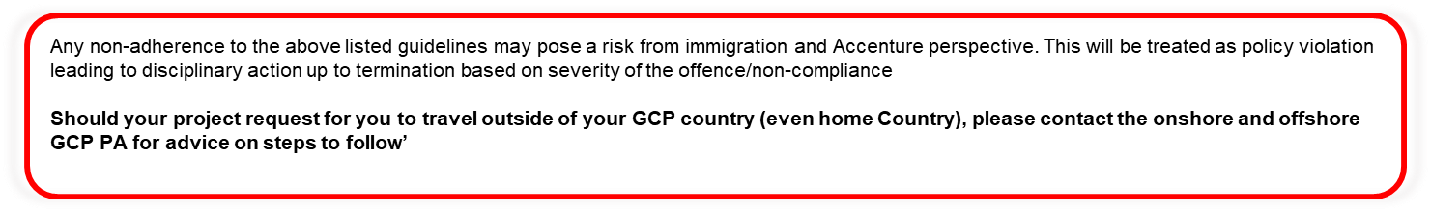
Do’s and Don'ts while travelling on GCP and while on GCP
Important note
DO‘S
1. Update visa copy on GCP HUB at least 6 working days prior to start date for initiation of the transfer process
2. Notify the GCP HR immediately about any change in the GCP start date (can be 1st or 16th only in case of
GCP to Germany/ Singapore/ UAE/ Netherlands/ Japan / France)
3. Employees should have a valid visa for travelling on GCP assignment
4. Employees should charge time and reimbursements to appropriate WBS while working in Host country
5. Employees should get in touch with the People mobility team at least 3 months in advance of the Visa/ Petition
expiry date
6. Retirement Age for GCP travelers is 60 years. Employees will have to abide by the retirement guidelines as per the
Home country norms
7. Employee should ensure taxation guidelines are followed and appropriate tax is filed in the Host and Home country
8. Employee should identify nominees for bank account, lockers, Insurance in Home and Host country
DONT‘s
Do not work from the home country during your GCP assignment term, as you are to work onshore in the host country. Seek approval from your host country Project Lead and People Advisor
Employee should not fill in timesheet with ATCI WBS while working in the Onshore country
Employee should not report to the work location or start working in the Host country before the GCP start date
Employees should not claim the visa expenses without receiving the approval from GCP team
Employees should not travel on GCP until the controllership checklist is approved on AST tool (Fresh Travelers)
At all times during your GCP assignment to any country, it is important you note that you are an ambassador of Accenture and that your "conduct counts". You are required to exercise due caution and have an obligation to comply with local laws of the country and Code of Business Ethics policy of Accenture. Some of the examples of behaviors that you could possibly refrain from include but not limited to gambling, shoplifting, prostitution, brawls, being party to any form of violence.

Slide 54
Assistance during an Emergency & Hoax Calls
Emergency Assistance
Hoax calls
The Accenture Security Operations Center (ASOC) provides a global point of contact for Accenture
employees to request urgent security assistance when a local Accenture security contact is not readily
available
When would you call ASOC? Some examples include the following:
You have lost your passport (or have been robbed) and cannot get home without it
You are being held without cause in a foreign country
You are aware of a danger to an Accenture location
You need advice to remain safe
You have lost your laptop or other electronic media storage device (like PDA, USB etc.) that contains Accenture associated data
Your spouse can reach out to this number, if he/she has not heard from you in an abnormal amount of time. When you are traveling to a new area and this behavior is out of the ordinary
For other routine matters please get in touch with your respective function contact points such as local HR, Workplace Solutions etc
ASOC is available 24 hours a day, seven days a week, 365 days a year at +1.202.728.0645. From India you can dial +91.80.4106 2762 (ASOC)
It has been bought to our attention that there have been some incidents of Accenture employees recently received a hoax call from someone claiming to be from Department of Immigration. The caller claimed that the individual’s immigration documents were not in order, and requested that a large sum of money be deposited to resolve the issue.
If you receive a call from someone claiming to represent the government or any of its agencies, please do the following:
Take the caller’s name, designation and contact details
Explain you will return the call after consultation with Accenture’s immigration team
Do not provide any personal bank account information or other financial information
Do not agree to make any payments or wire transfers
If you believe you have received a hoax call please let us know so that we can monitor the impact for Accenture.
Contact details:
People Mobility Service Now Tool
Please also report any such calls that you suspect to be fraudulent to the Global Asset Protection Hotline: +1 202 728 0645 (staffed 24/7) or via email: asset_protection@accenture.com

Slide 55

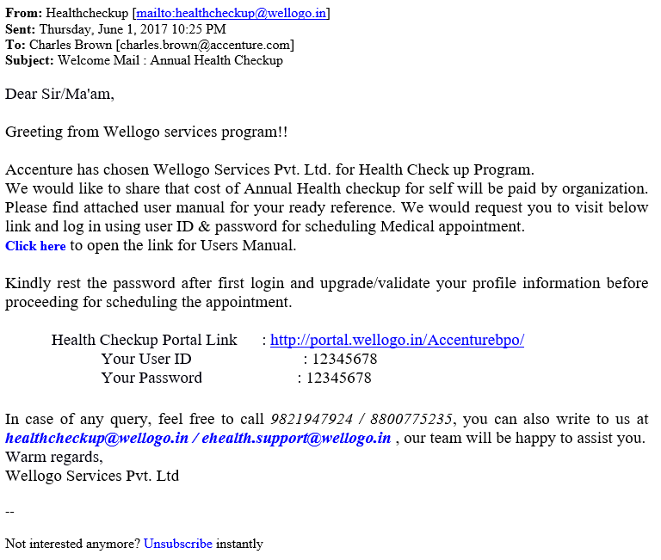
Phishing Mail Alert
Below are the examples of an actual email (employee’s info has been changed) that was received by a GCP employee. This is a Phishing Email. If you receive an email like this, or any type of suspicious email, please report it immediately! You can report the email by clicking on the “Report Phishing” icon in Outlook. Do Not click on any of the links in the email.

Slide 56
To-do’s at the time of Medical Emergency
Important points to be followed in case of medical emergency or any unforeseen event happens with Employee or dependents (Spouse and Children)
Employees are required to keep the local HR and GCP HR informed about the situation apart from Project Manager / Project MD and Global Asset team. For Global Asset team details refer to the ASOC slide
The HR team and GCP Operations team will ensure that immediate assistance is provided by looping the right PoC hence please restrict the email chain
Please make sure that the employee is attended by an immediate family member ( where applicable spouse) as soon as possible, Someone who is a dependent or family member need to provide sign off on medical procedures and next steps
Do not offer a position or take any decision if you are not authorized.
Updates needs to be shared with GCP HR, Operations team, Local HR and GAP team so that they can monitor the situation and assistance can be provided
Only the family member or the authorized Point of Contact should interact with Doctors and other authorities
Communication to the extended family member should be initiated by the authorized Point of Contact appointed by Accenture
Approval from the respective leadership is required before considering or approving any costs
Please comply and co-operate with the authorities of the law and medical professional
For any further clarification, please connect with bharani.bs@accenture.com from GCP Operations team.

Slide 57
Lease Breakage Cost
Important Note
Employees should not enter any lease with special clauses such as – in case of lease breakage the rent has to be paid till the next tenant occupies the facility. In all other scenarios like employee initiated roll off, the lease breakage should be borne by the employee
In all cases where costs are incurred by the employee due to earlier than planned termination of the assignment, these will be absorbed by the project releasing the resource whether or not employee has found another role elsewhere in the host country. In the case of employee initiated termination of assignments, employees are responsible for incurring lease breakage costs. This is applicable only for housing/ apartment lease and does not apply to car lease, mobile phone lease or any other such arrangements.
In the event of a planned end date of the GCP assignment, which is lesser than the lease period, then the below has to be adhered to:
“Before signing the agreement, the employee should inform the project on the lease agreement duration if it is greater than the planned GCP assignment duration, so that there is a mutual agreement between the project & the employee with regards to picking up the cost. If the employee has not informed the project & has signed the lease agreement which is greater than the planned assignment duration, then it is not mandatory for the project to pick the cost & can apply discretion”
One can refer to the GCP Costing & Operating guide (Link available to Level 7 & above): https://sites.accenture.com/groups/DCNforTech/TopicPages/Sell%20Solution%20Planning.aspx
Refer to the attached Navigation Guide to access the GCP Costing Guide and Rate Card
Employees are advised to sign an accommodation lease less than equal to project commitment. Employee should read the clause of Lease agreement carefully and seek consent from project before signing the lease. The project is responsible for reimbursement of lease breakage fees (for the commitment period) in cases where the project terminates the employee’s role prior to the end of the commitment period or the employee is asked to relocate to a new city for the purpose of work while on the project.

Slide 58

ANNEXURE

Slide 59
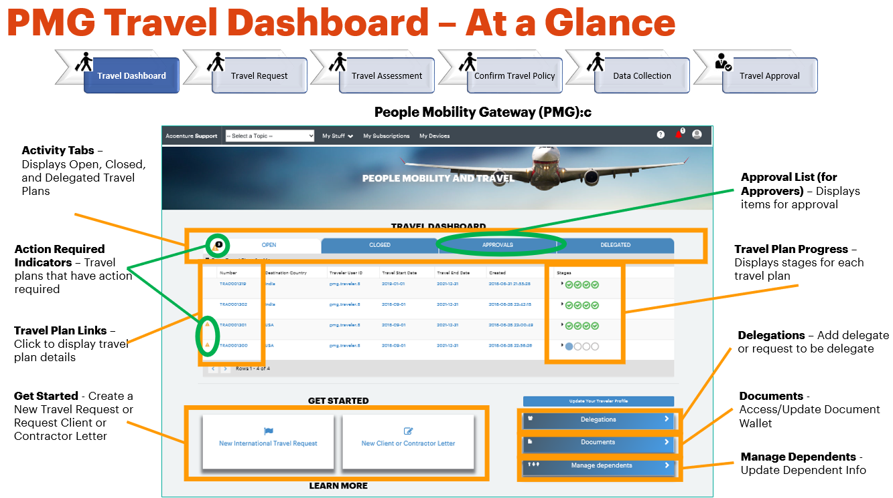
Snapshot & Info- Payslip, People Mobility Gateway & Language Training
GCP Training Guidelines
For employees to participate in training programs during the host country Global Careers Program transfer, an explicit approval from the home country training approver should be obtained
For any further queries on GCP Training guidelines, one can write to IDC.GCP. Training. For more info, please go though training guidelines updated in GCP HUB (accenture.com)
Programs suggested by the Learning and Talent team are as below
Inclusion & Diversity in Motion: Embracing Cross-cultural Diversity
is a 30-minute CBT designed to provide participants an introduction to cross-cultural diversity, how it affects your work and creates value for our clients.
Effective Cross- cultural Communication
is a 120 minutes CBT that aims to provide real life solutions to communication issues arising from cross cultural differences. The main objective of this course is to provide helpful, practical techniques and useful solutions to cross cultural communication issues.
https://in.accenture.com/inclusionanddiversity/cross-cultural/country-cultural-cards/
Language Training- Rosetta Stone Tool:
Rosetta Stone Tool combines advanced interactive technology, native speaker accent and rich visual environment to effectively teach the language. It is an opportunity provided by Accenture to learn reading, speaking and writing German
Employee should refer the embedded document for detailed information on the Rosetta Stone Tool Language training guideline and POC to contact in order to gain access.

Slide 60


GEMS
(GCP Exchange Messaging Solution)
What is GEMS?
GEMS is a virtual interactive assistance to answer queries at your pace and space. It’s a cognitive bot designed to simulate conversation with employees
How does GEMS work?
GEMS listens and learns from your queries and helps you better
How to get started?
Login to GCP HUB (accenture.com) and click on the “Ask GEMS” icon to start a chat
GEMS

Slide 61

THANK YOU

